Slide 1

MapReduce

Slide 2
What is MapReduce?

Slide 3
What is MapReduce?
Map( )
Problem
Sub-Problem
Sub-Problem
Sub-Problem
Sub-Problem
Sub-Problem

Slide 4
What is MapReduce?
Sub-Solution
Sub-Solution
Sub-Solution
Sub-Solution
Sub-Solution

Slide 5
What is MapReduce?
Sub-Solution
Sub-Solution
Reduce( )
Sub-Solution
Sub-Solution
Sub-Solution
Solution

Slide 6
Why MapReduce?

Slide 7
Why MapReduce?
40 seconds

Slide 8
Why MapReduce?
1 second
x40 incase you’re wondering

Slide 9
Why MapReduce?
INPUT
OUTPUT
128 MB/second

Slide 10
Why MapReduce?
IN
OUT
5120 MB/second

Slide 11
Why MapReduce?
Running

Slide 12

Why MapReduce?
Not Running

Slide 13

Why MapReduce?
Still Running
x40 again incase you’re wondering

Slide 14
Why MapReduce?
Still Running
x40 again incase you’re wondering

Slide 15
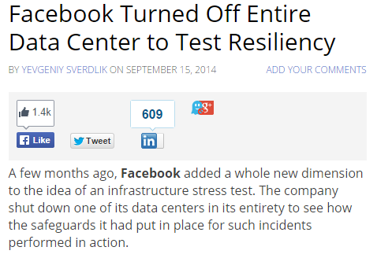
Why MapReduce?
http://www.datacenterknowledge.com/archives/2014/09/15/facebook-turned-off-entire-data-center-to-test-resiliency/

Slide 16
Who MapReduces?

Slide 17










Who MapReduces?

Slide 19
‘s
MapReduce

Slide 20
‘s MapReduce
MapReduce
File System
BigTable

